Slide 1


YASH TECHNOLOGIES
INDORE
Topic – Operating System and Installation

Slide 2
Content
Introduction
Features
Basics of Windows and Ubuntu
Virtual Box
Installation

Slide 3
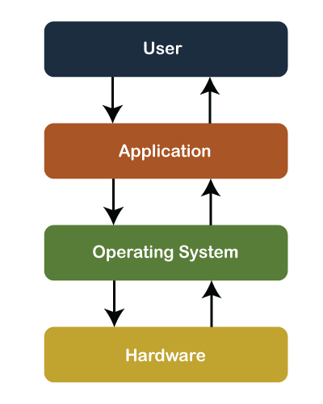
Introduction
Operating System -
Computer System = Hardware + Software
Software = Application Software + System Software(OS)
An Operating System is a system Software that acts as an interface between a user of a computer and the computer hardware.

Slide 4
Features
Features-
Security Management
Storage and Memory Management
I/O Operations
Hardware Interdependence
Provides User Interface

Slide 5
Basics of Windows and Ubuntu
Windows | Ubuntu
Windows operating system is developed by Microsoft | Ubuntu operating system is developed by Canonical Ltd
It is a closed source software. | It is an open source software
Users need to have a valid and authenticated license to use it | Users need not to have a license to use it.
Default user interface is Windows Shell. | Default user interface is Ubuntu unity, GNOME
Windows is very easy to learn and start with as compared to Ubuntu . | Ubuntu is not easy to learn and start with as compared to windows as it mainly works with commands
Windows operating system belongs to Windows NT family. | Ubuntu operating system belongs to Linux family.

Slide 6
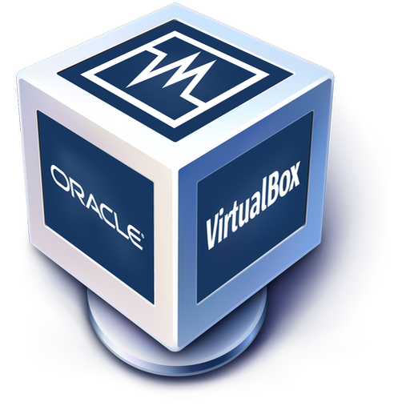
Virtual Box
Oracle VM VirtualBox, the world’s most popular open source, cross-platform, virtualization software, enables developers to deliver code faster by running multiple operating systems on a single device.
IT teams and solution providers use VirtualBox to reduce operational costs and shorten the time needed to securely deploy applications on-premises and to the cloud

Slide 7
Installation
Step 1.
Install Virtual Box in your Laptop , Given Link Below
https://www.virtualbox.org/wiki/Downloads
Step 2.
Download Ubuntu GUI Image , Given Link Below
https://ubuntu.com/download/desktop

Slide 8
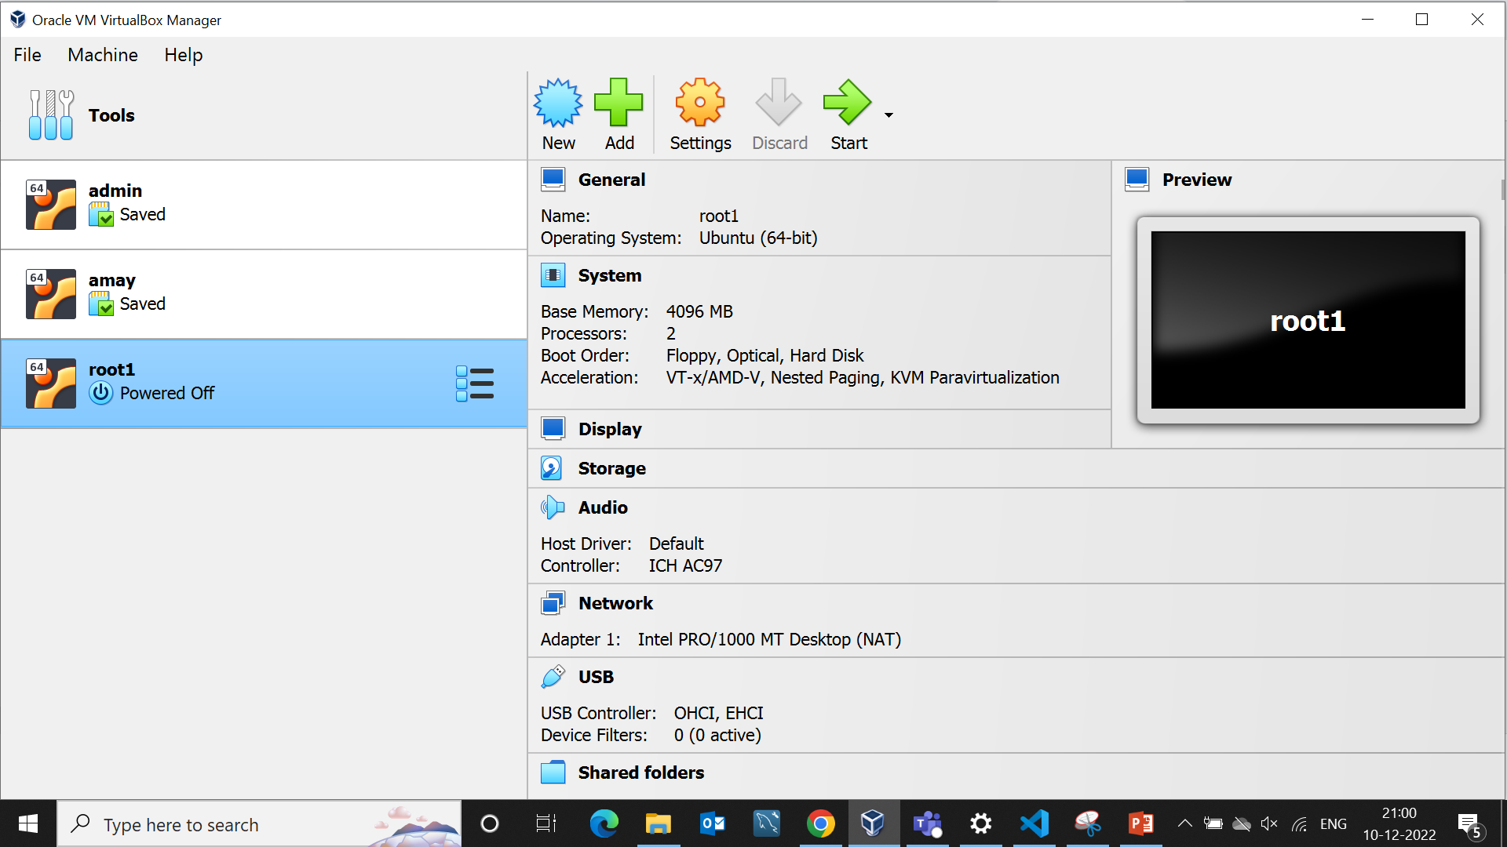
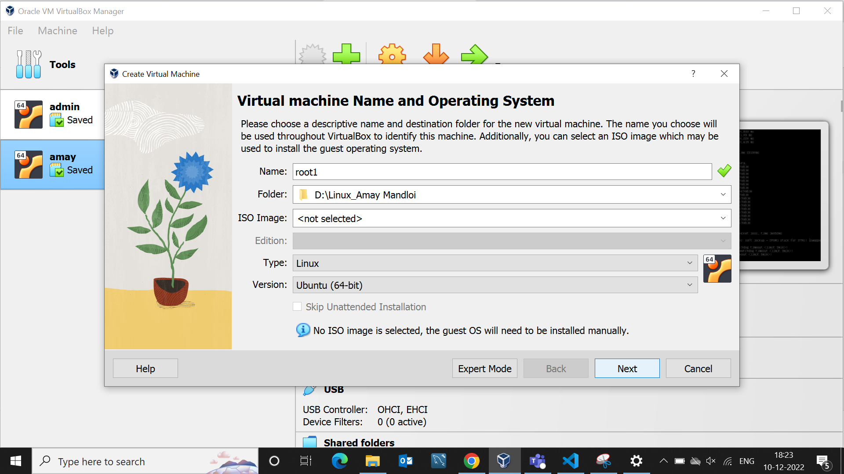
Installation
Step 3.
Step 4.
Click To New For Create Virtual Desktop
Open Virtual Box
Fill The Details and Select Type of OS

Slide 9
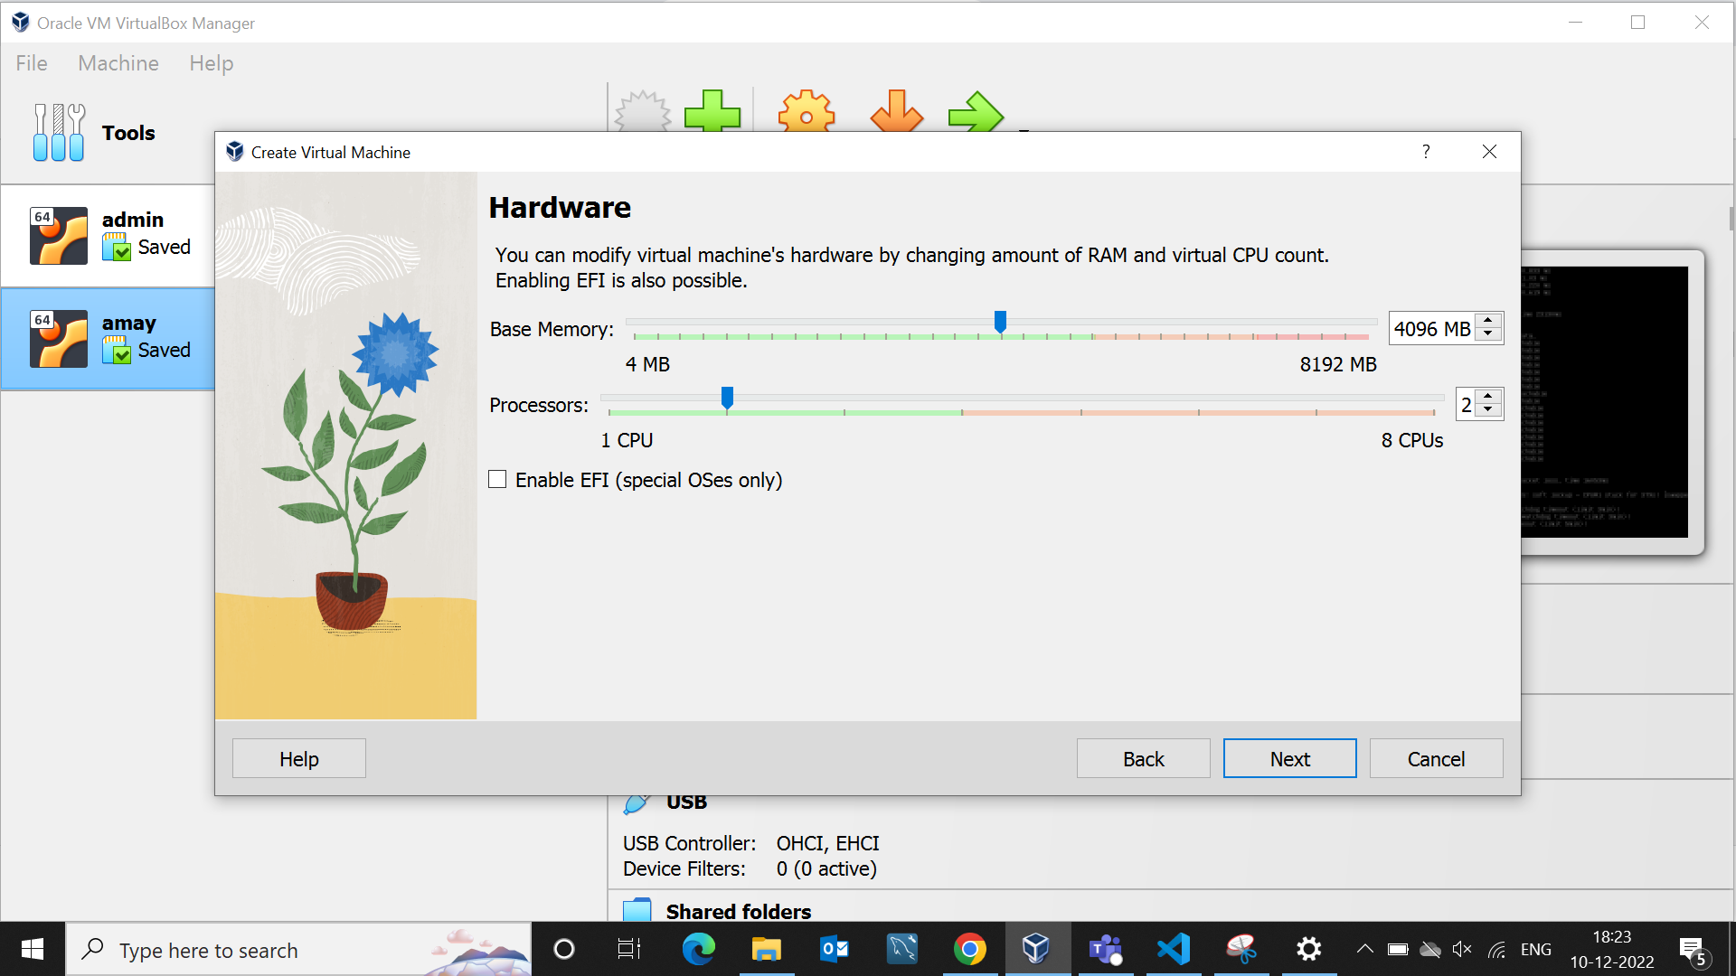
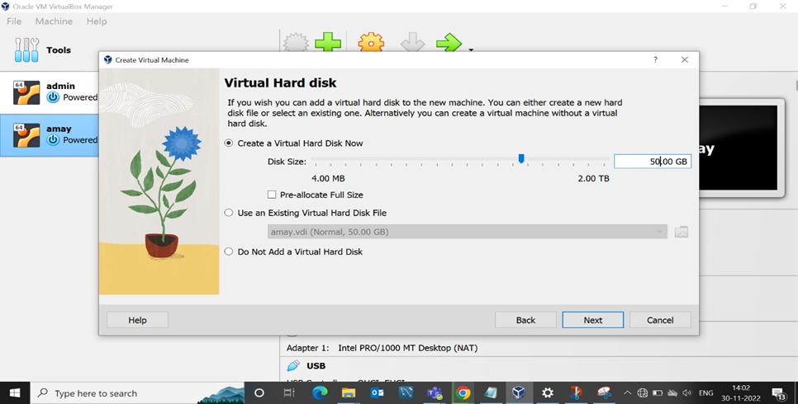
Step 5.
Step 6.
Configure Hardware Memory(RAM) and CPU
Create Virtual Hard Disk – 50 GB
Select 4GB Ram And 2 CPU

Slide 10
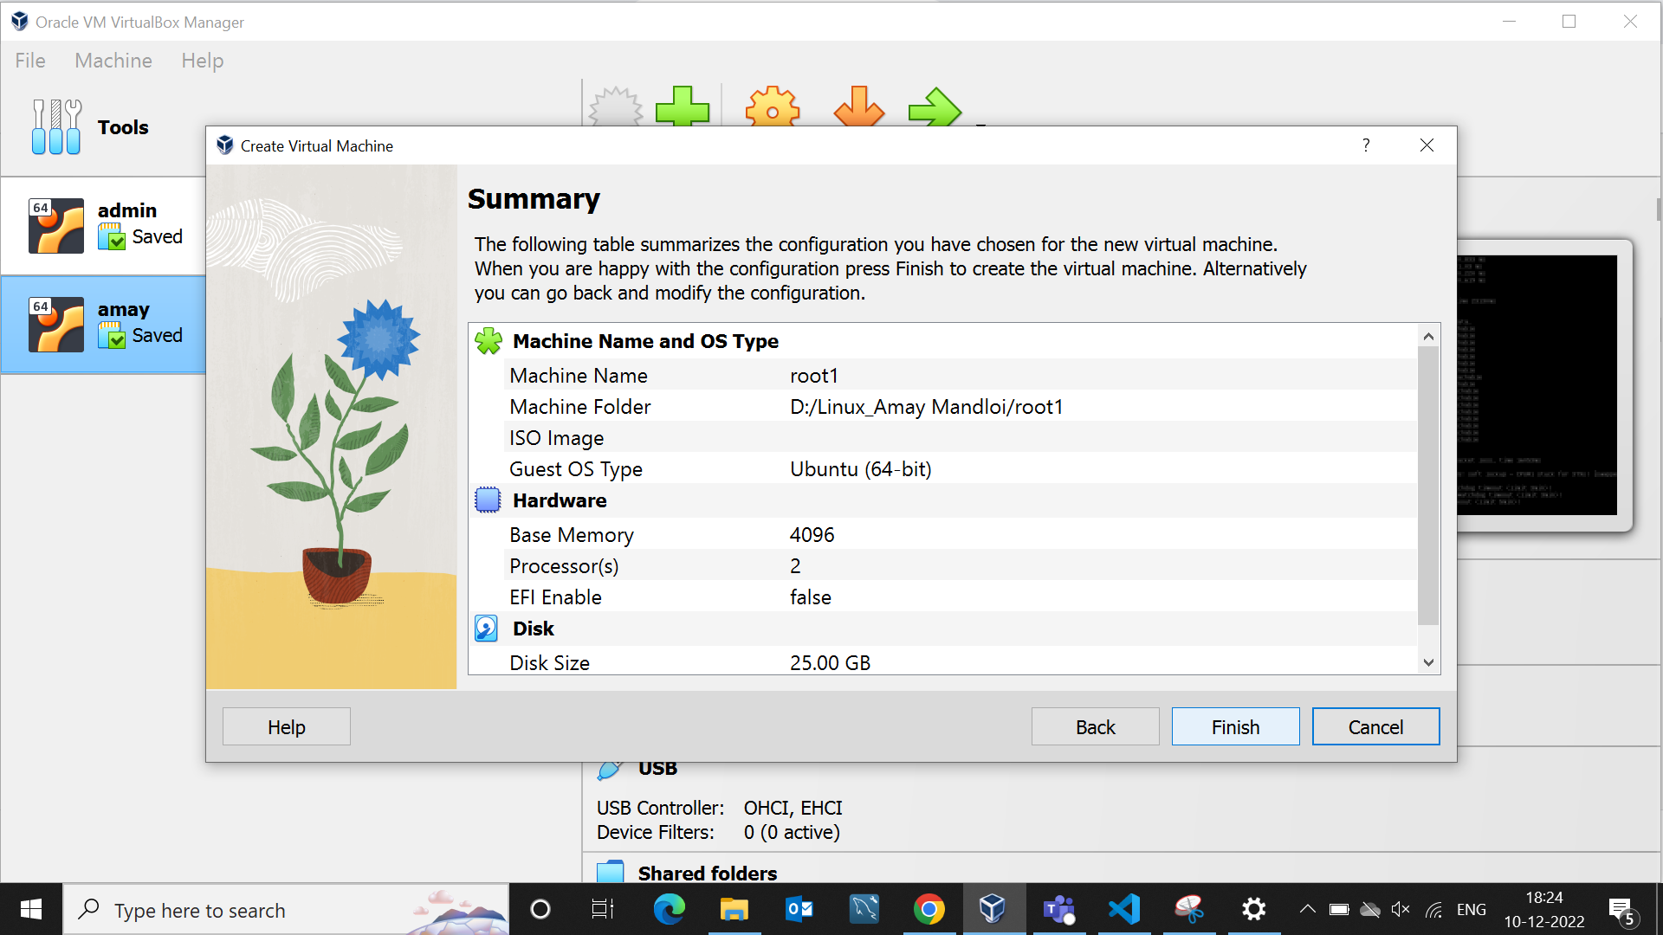
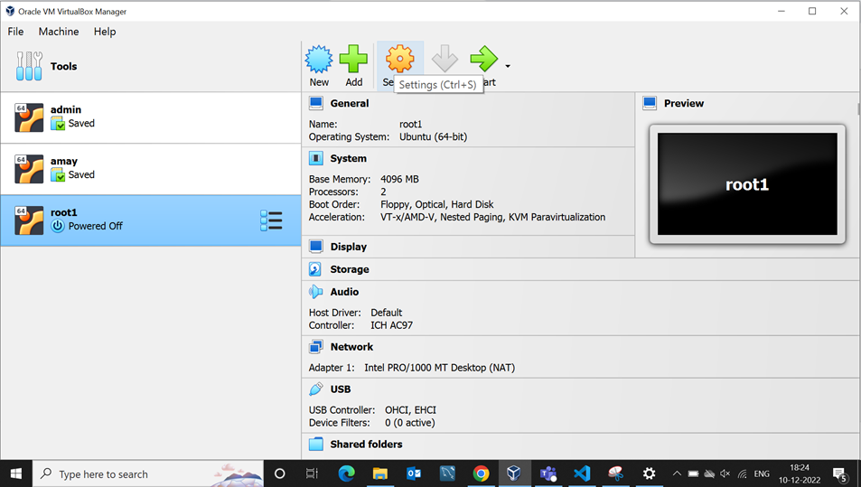
Step 7.
Step 8
Complete Summary For Hardware
Configuration
Go to Virtual Box Setting

Slide 11
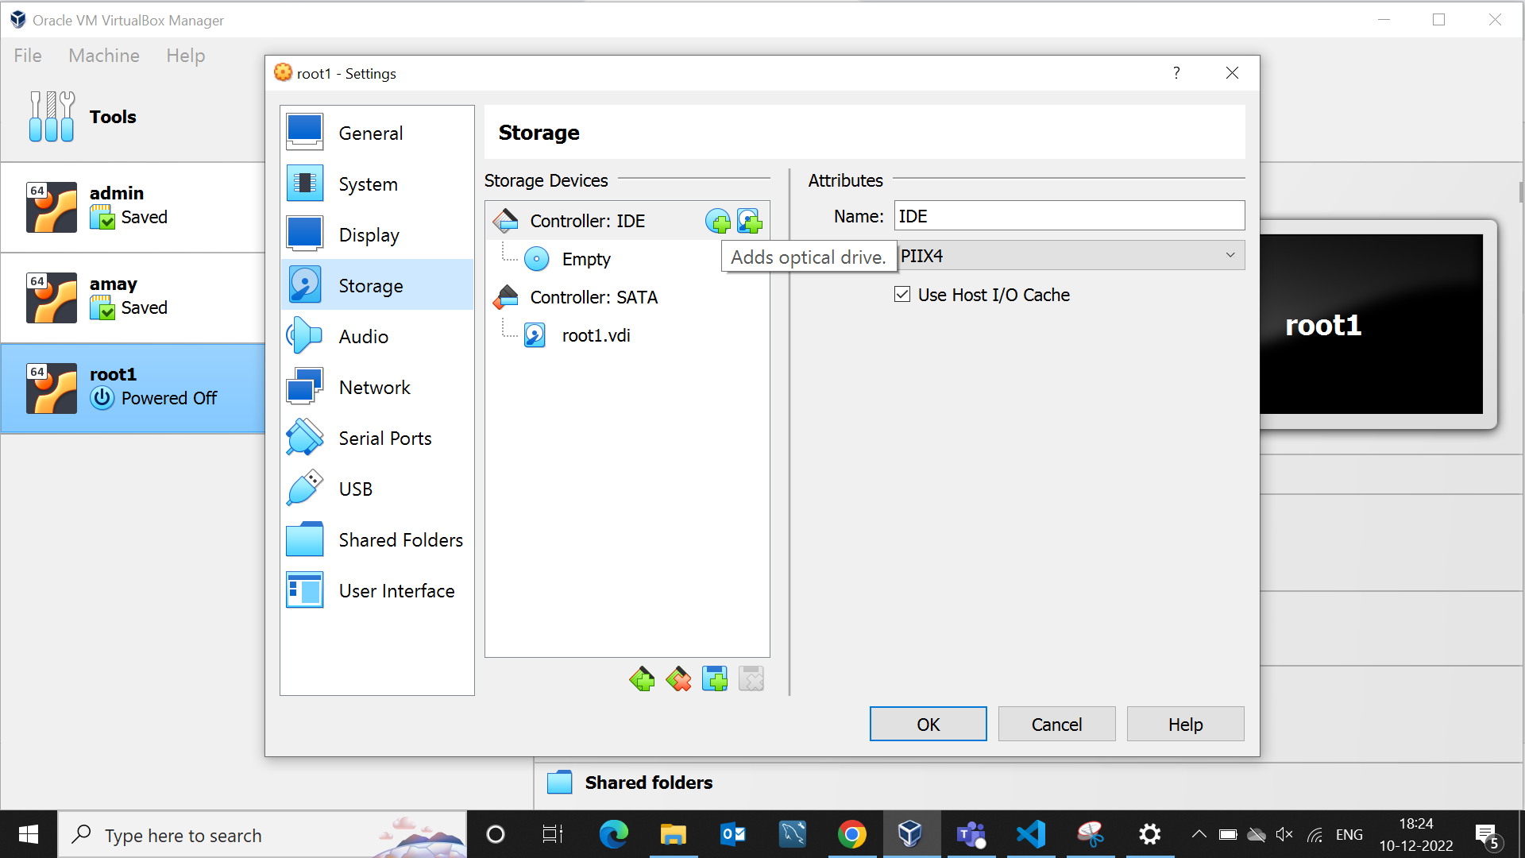
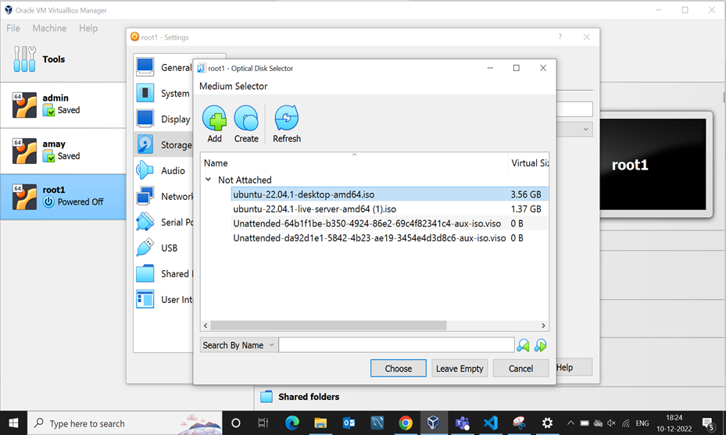
Installation
Step 9.
Step 10.
Go to Storage and Add Ubuntu Image
Choose Ubuntu Desktop

Slide 12
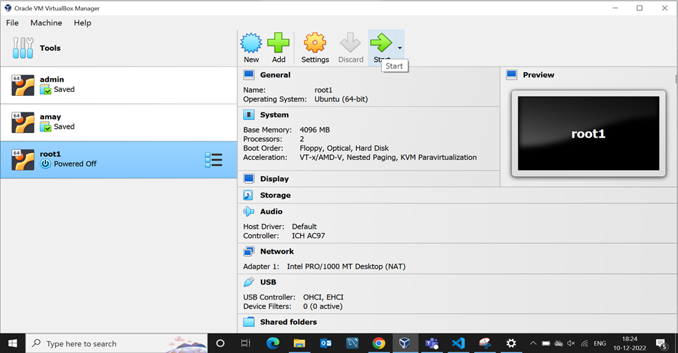
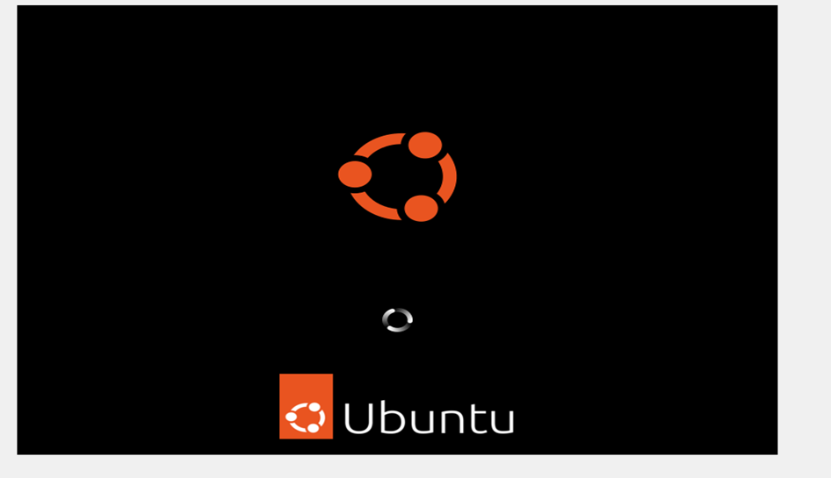
Step 11.
Step 12.
Start Virtual Desktop
Start Ubuntu Desktop

Slide 13
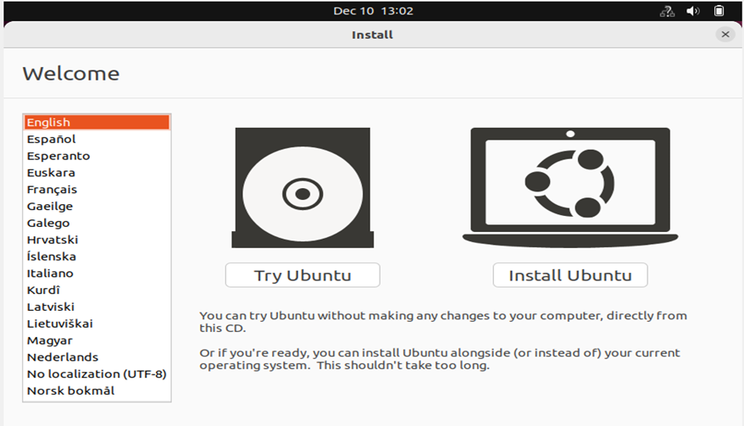
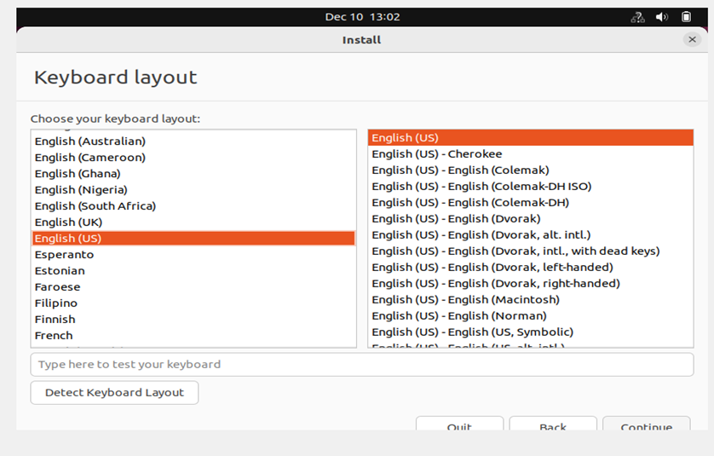
Step 13.
Step 14
Install Ubuntu
Select Keyboard Layout English (US)

Slide 14
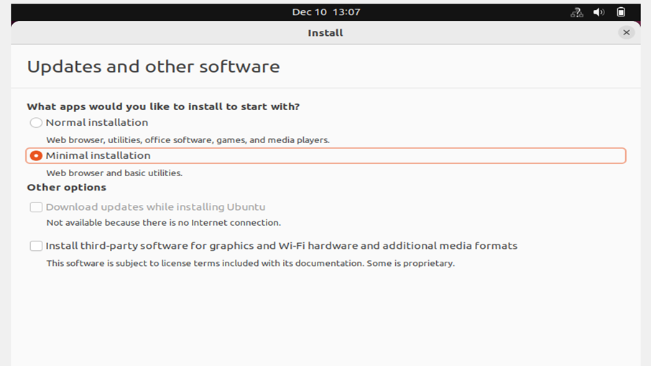
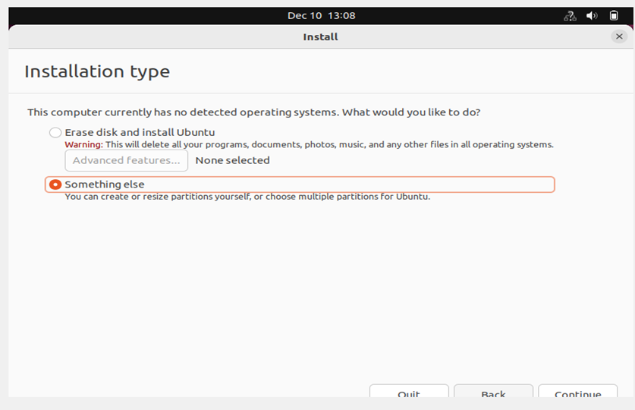
Installation
Step 15.
Step 16.
Updates and Other Software Select
Minimal Installation
Installation type Select Something else

Slide 15
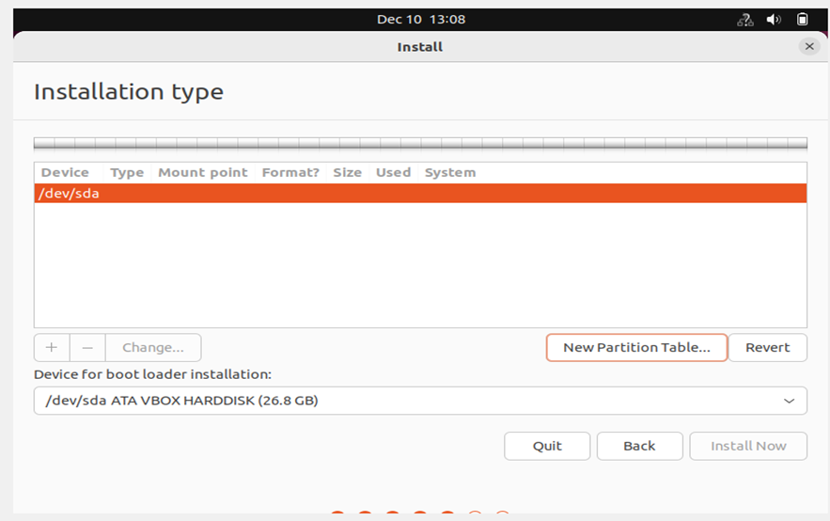
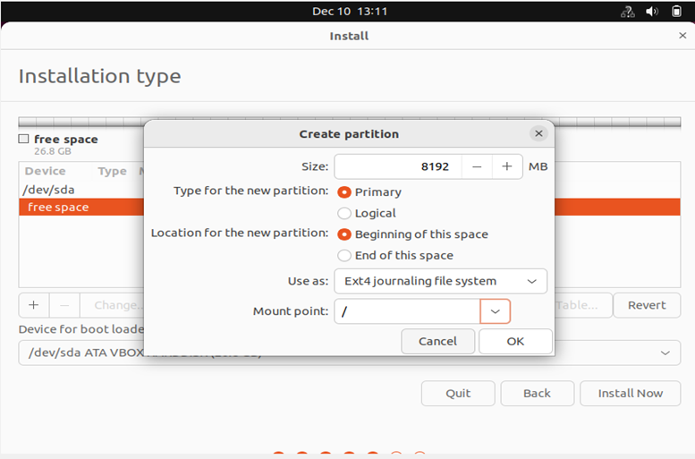
Step 17.
Step 18.
Create New Partition Table
Create Partition Disk Select Mount for / (8GB)

Slide 16
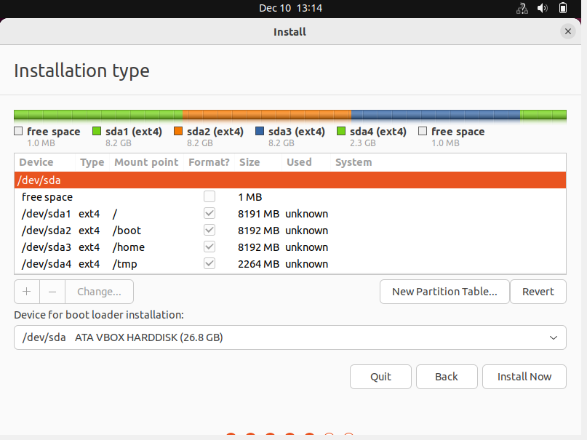
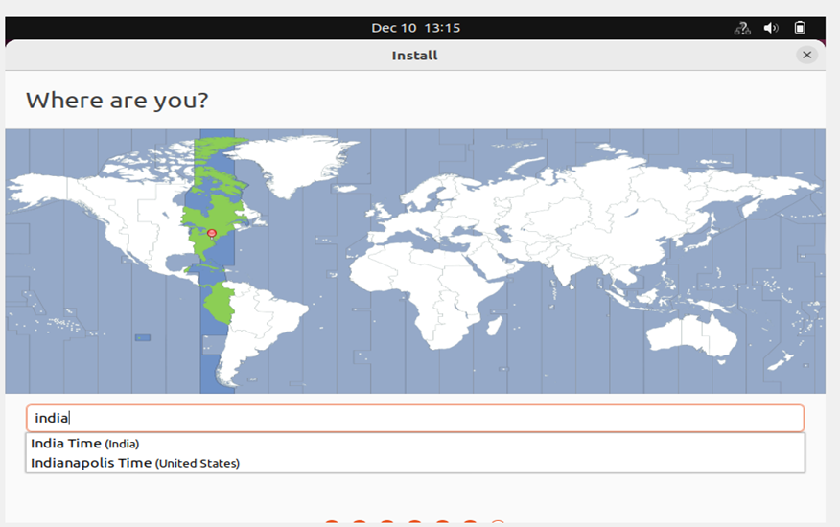
Installation
Step 19.
Step 20.
Compete Mount Point Partition
Select Location-India

Slide 17
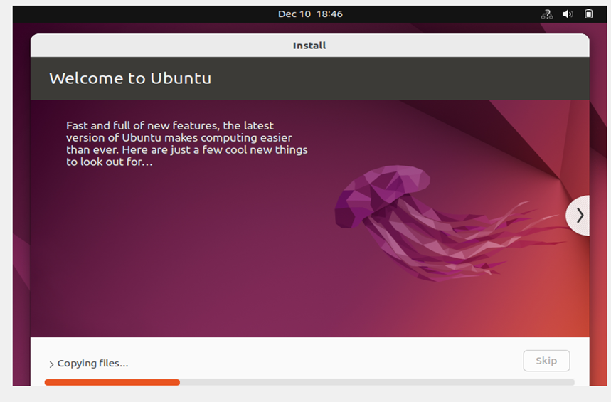
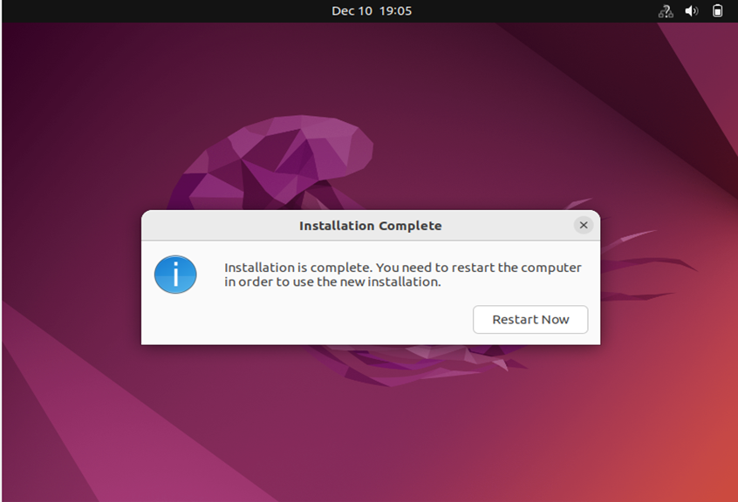
Installation
Step 21
Step 22
Welcome to Ubuntu
Installation Complete And Than Restart Now

Slide 18
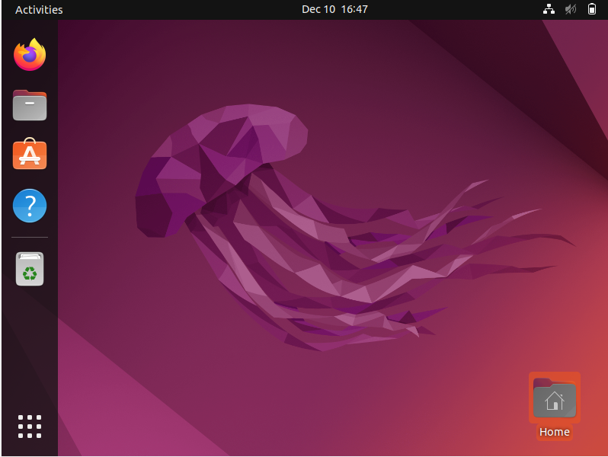
Installation

Slide 19


